Slide 1

Week at A Glance for Science
January
23-27
Weather and
Climate

Slide 2
S6E4. Obtain, evaluate, and communicate information about how the sun, land, and water affect climate and weather.
c. Develop a model demonstrating the interaction between unequal heating and the rotation of the Earth that causes local and global wind systems.
d. Construct an explanation of the relationship between air pressure, weather fronts, and air masses and meteorological events such as tornados and thunderstorms.

Slide 3
S6E4. Obtain, evaluate, and communicate information about how the sun, land, and water affect climate and weather.
Analyze and interpret data to compare and contrast the composition of Earth’s atmospheric layers (including the ozone layer) and greenhouse gases. (Clarification statement: Earth’s atmospheric layers include the troposphere, stratosphere, mesosphere, and thermosphere.)
Plan and carry out an investigation to demonstrate how energy from the sun transfers heat to air, land and water at different rates. (Clarification statement: Heat transfer should include the processes of conduction, convection, and radiation.)
Develop a model demonstrating the interaction between unequal heating and the rotation of the Earth that causes local and global wind systems.
d. Construct an explanation of the relationship between air pressure, weather fronts, and air masses and meteorological events such as tornados and thunderstorms.
e. Analyze and interpret weather data to explain the effects of moisture evaporating from the ocean on weather patterns and weather events such as hurricanes.

Slide 4
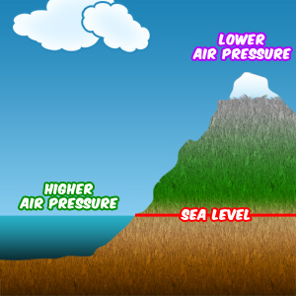
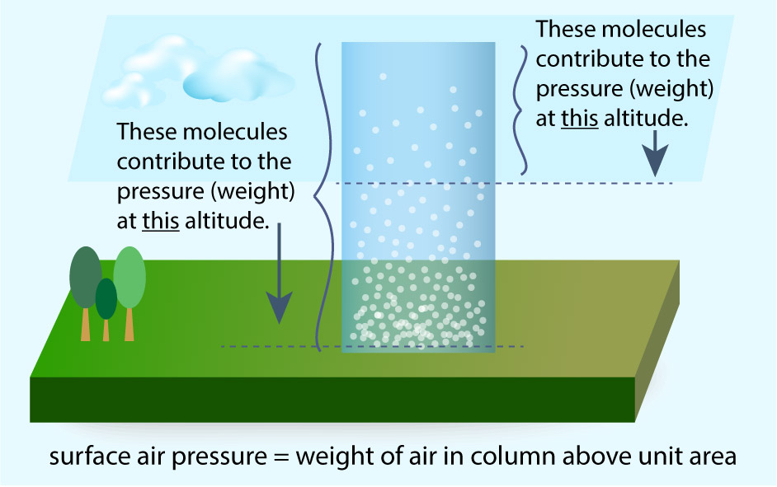

Slide 5
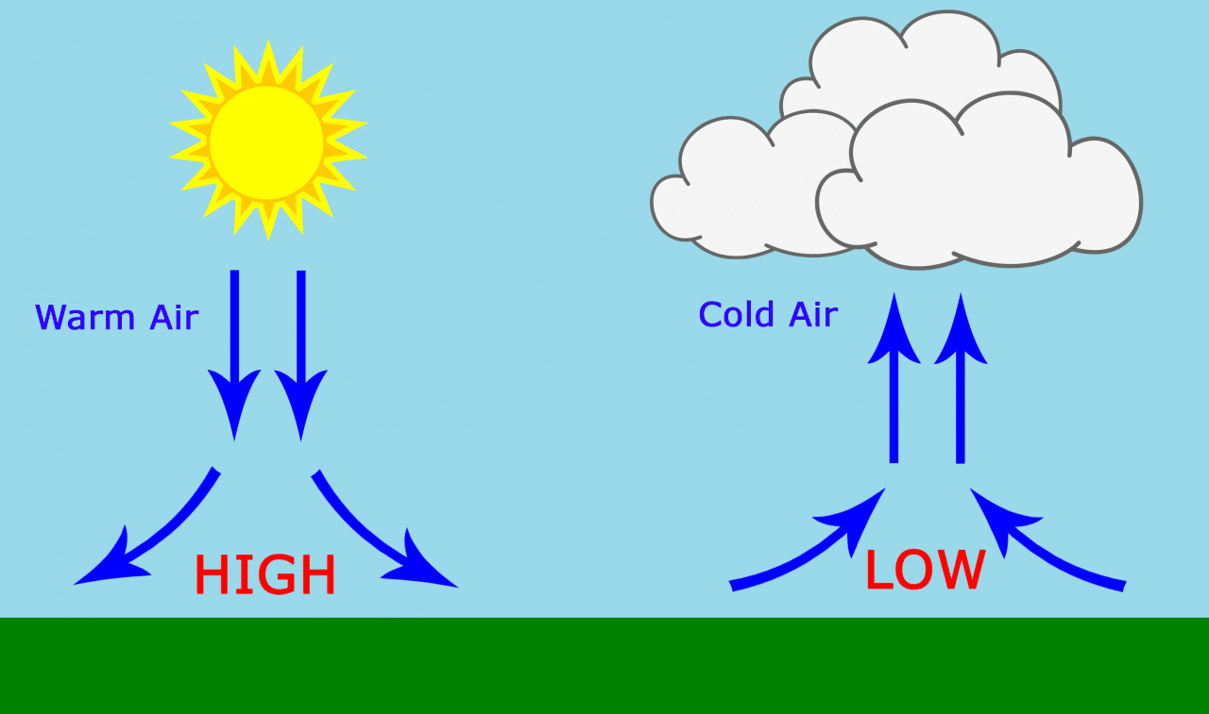

Slide 6
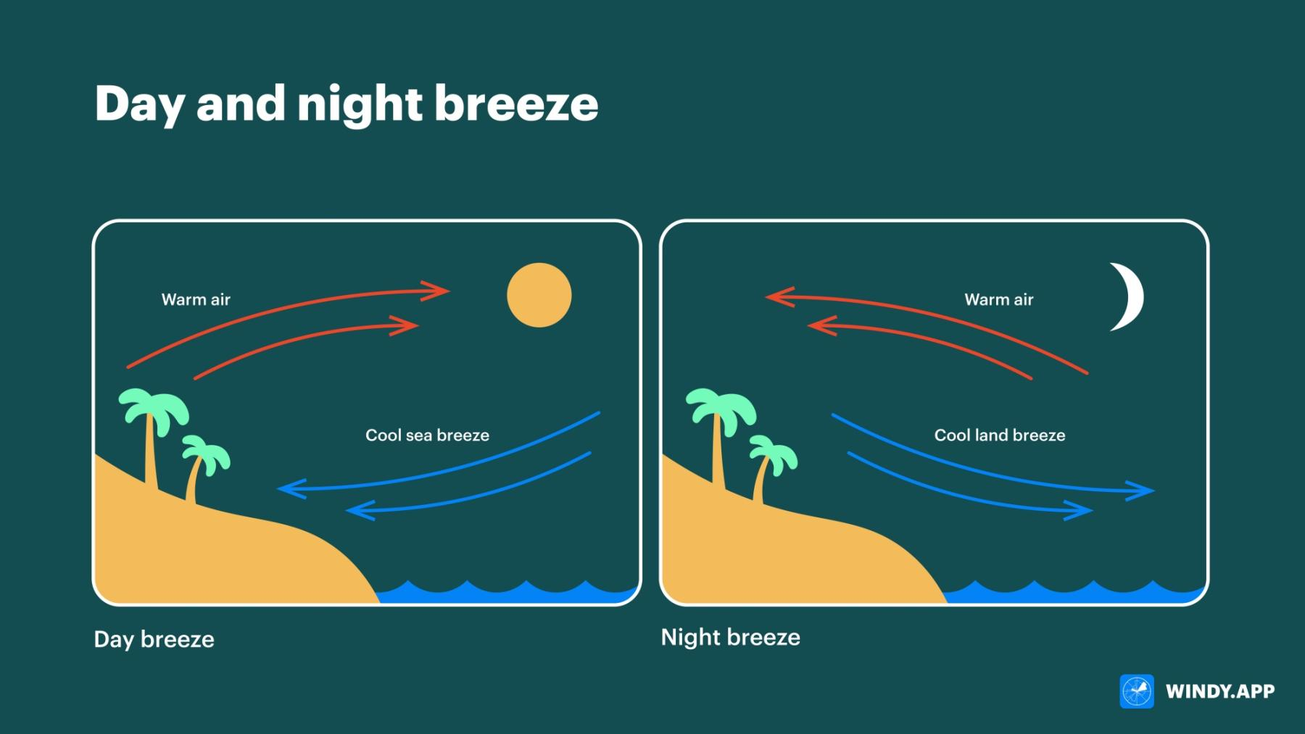

Slide 7
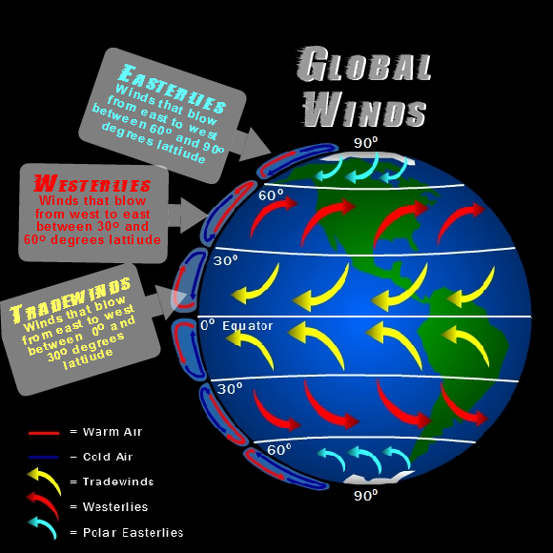

Slide 8
What causes the wind to blow?
How is wind created? The uneven heating of the Earth's surface by the sun creates wind. What causes the wind to blow? As the sun warms the Earth's surface, the atmosphere warms too. Some parts of the Earth receive direct rays from the sun all year and are always warm. Other places receive indirect rays, so the climate is colder. Warm air, which weighs less than cold air, rises. Then cool air moves in and replaces the rising warm air. This movement of air is what makes the wind blow

Slide 9
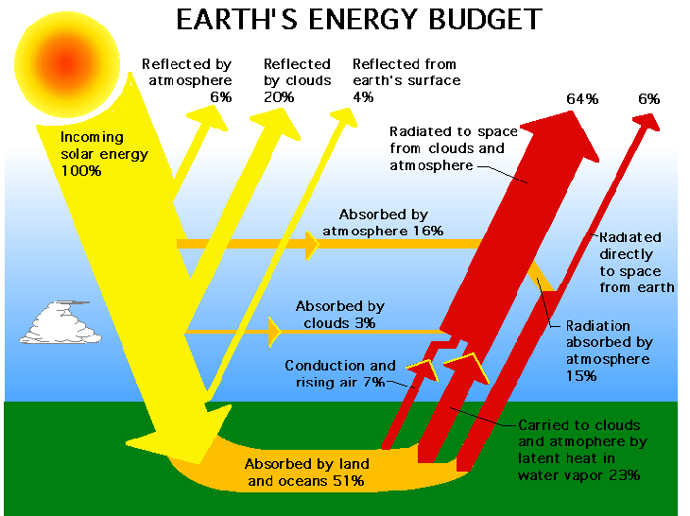
Plan and carry out an investigation to demonstrate how energy from the sun transfers heat to air, land and water at different rates.
(Clarification statement: Heat transfer should include the processes of conduction, convection, and radiation.)

Slide 10
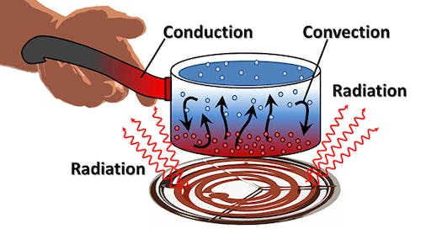

Slide 11
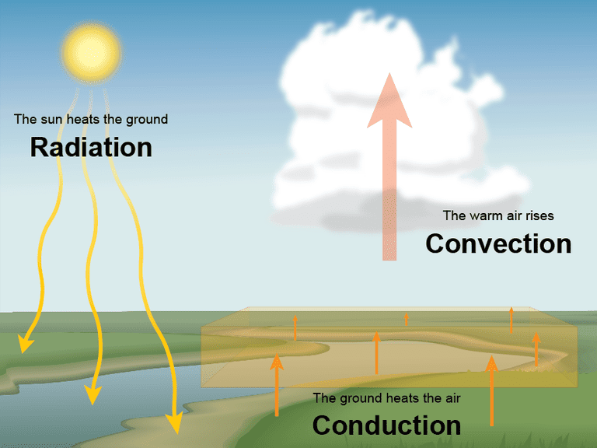
S6E4. Obtain, evaluate, and communicate information about how the sun, land, and water affect climate and weather.
B Plan and carry out an investigation to demonstrate how energy from the sun transfers heat to air, land and water at different rates. (Clarification statement: Heat transfer should include the processes of conduction, convection, and radiation.)
C Develop a model demonstrating the interaction between unequal heating and the rotation of the Earth that causes local and global wind systems.

Slide 13
radiation is the emission or transmission of energy in the form of waves or particles through space or through a material medium.
Conduction is the process by which heat is transferred from the hotter end to the colder end of an object. The ability of the object to conduct heat is known as its thermal conductivity, and is denoted k.
Convection the movement caused within a fluid by the tendency of hotter and therefore less dense material to rise, and colder, denser material to sink under the influence of gravity, which consequently results in transfer of heat.

Slide 14
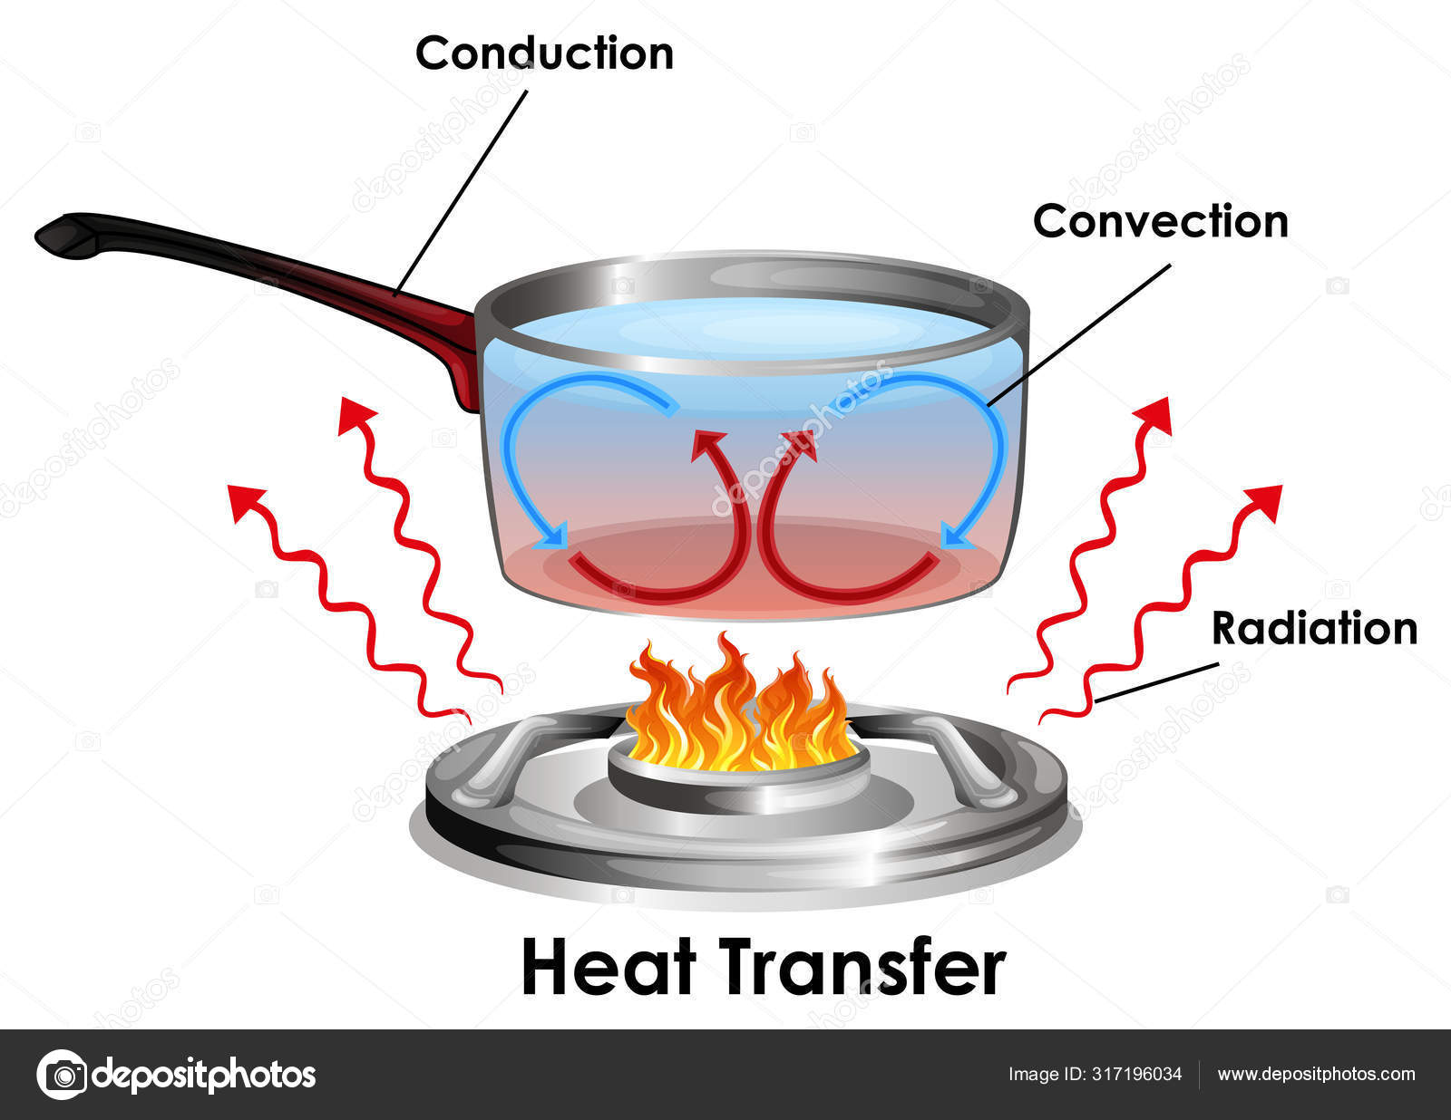
Video link: Conduction, Convection, Radiation
Video Link; Heat Transfer

Slide 15
Monday, January 23
Standard: S6E4. c)
Develop a model demonstrating the interaction between unequal heating and the rotation of the Earth that causes local and global wind systems.
Learning Target: I can explain how unequal heating and Earth’s rotation causes local and global wind systems.
Warm-up: Chapter 11 Workbook Packet
Work Session: Unit: 3 Weather and Climate; Review for Quiz
Closing: Think Pair Share
Reminders: Quiz on Wednesday

Slide 16
Tuesday, January 24
Standard: S6E4. c-d
Develop a model demonstrating the interaction between unequal heating and the rotation of the Earth that causes local and global wind systems.
Learning Target: I can explain how unequal heating and Earth’s rotation causes local and global wind systems.
Warm-up: Chapter 11 Workbook Packet
Work Session: Unit: 3 Weather and Climate
Closing: Think Pair Share
Reminders: Quiz on Wednesday

Slide 17
Wednesday, January 25
Standard: S6E4.d Construct an explanation of the relationship between air pressure, weather fronts, and air masses and meteorological events such as tornados and thunderstorms.
Learning Target: I can explain how the suns’ energy heats earth causing air pressure, air masses, and weather fronts that causes major weather events.
Warm-up: Chapter 11 Workbook Packet
Work Session: Unit: 3 Weather and Climate; TB Wind Systems, weather fronts, air masses;
Closing: TOD
Reminders: Quiz

Slide 18
Thursday, January 26
Standard: S6E4.d Construct an explanation of the relationship between air pressure, weather fronts, and air masses and meteorological events such as tornados and thunderstorms.
Learning Target: I can explain how the suns’ energy heats earth causing air pressure, air masses, and weather fronts that causes major weather events.
Warm-up: Chapter 11 Workbook Packet
Work Session: Unit: 3 Weather and Climate; TB Weather fronts and air masses; Quiz Science Fair Project
Closing: Student Summarize
Reminders:

Slide 19
Friday, January 27
Standard: S6E4.d Construct an explanation of the relationship between air pressure, weather fronts, and air masses and meteorological events such as tornados and thunderstorms.
Learning Target: I can explain how the suns’ energy heats earth causing air pressure, air masses, and weather fronts that causes major weather events.
Warm-up: Chapter 13 Workbook Packet
Work Session: Unit: 3 Weather and Climate; TB Tornadoes and Thunderstorms
Science Fair Project
Closing: Think Pair Share
Reminders:

Slide 20
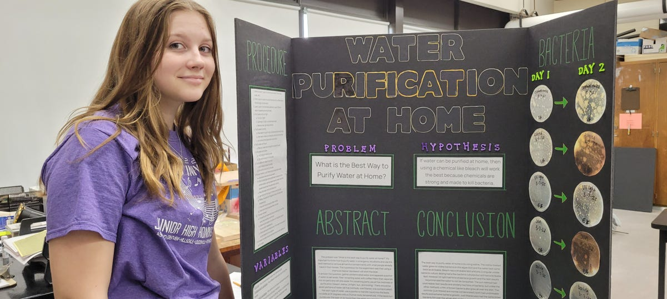
Science Fair Project
Video Link to How to do a Science Fair Project

Slide 21

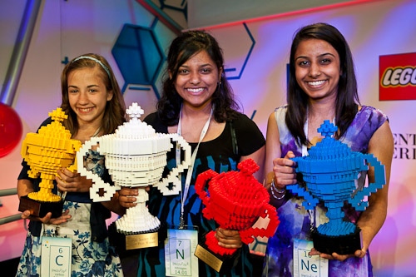
Video Link to video

Slide 22
